Slide 1
FARMING IN THE DIGITAL AGE
Getting Started with Farming
in Real Estate
Presented By: Allie Flath, MyHome & WFG National Title

Slide 2
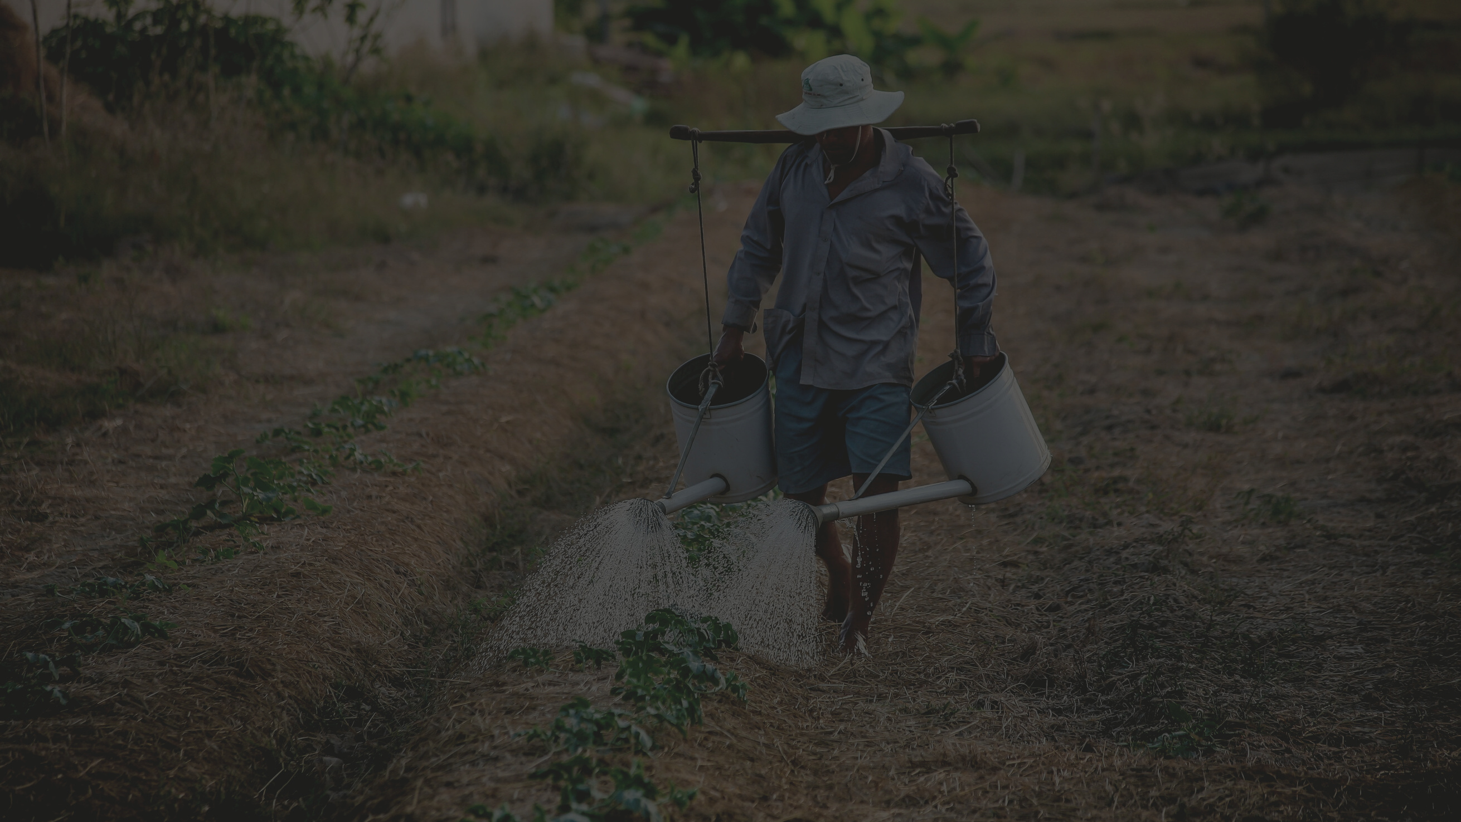
Self-discipline is an act of cultivation. It requires you to connect today's actions to tomorrow's results. There's a season for sowing a season for reaping. Self-discipline helps you know which is which.
GARY RYAN BLAIR

Slide 3
What is Real Estate Farming?
The act of focusing the bulk of your marketing efforts on a specific area (geographic farming) or certain types of clients (demographic farming) as an expert in that area. Real estate farming equates your marketing efforts to sowing seeds on a farm.
CROPS TAKE TIME AND PATIENCE TO BE FRUITFUL, BUT IF YOU’RE WILLING TO DO THE WORK IN THE BEGINNING AND WAIT FOR ROOTS TO TAKE HOLD, YOU’LL FIND THAT THE PAYOFF IS WELL WORTH THE INITIAL EFFORT.

Slide 4
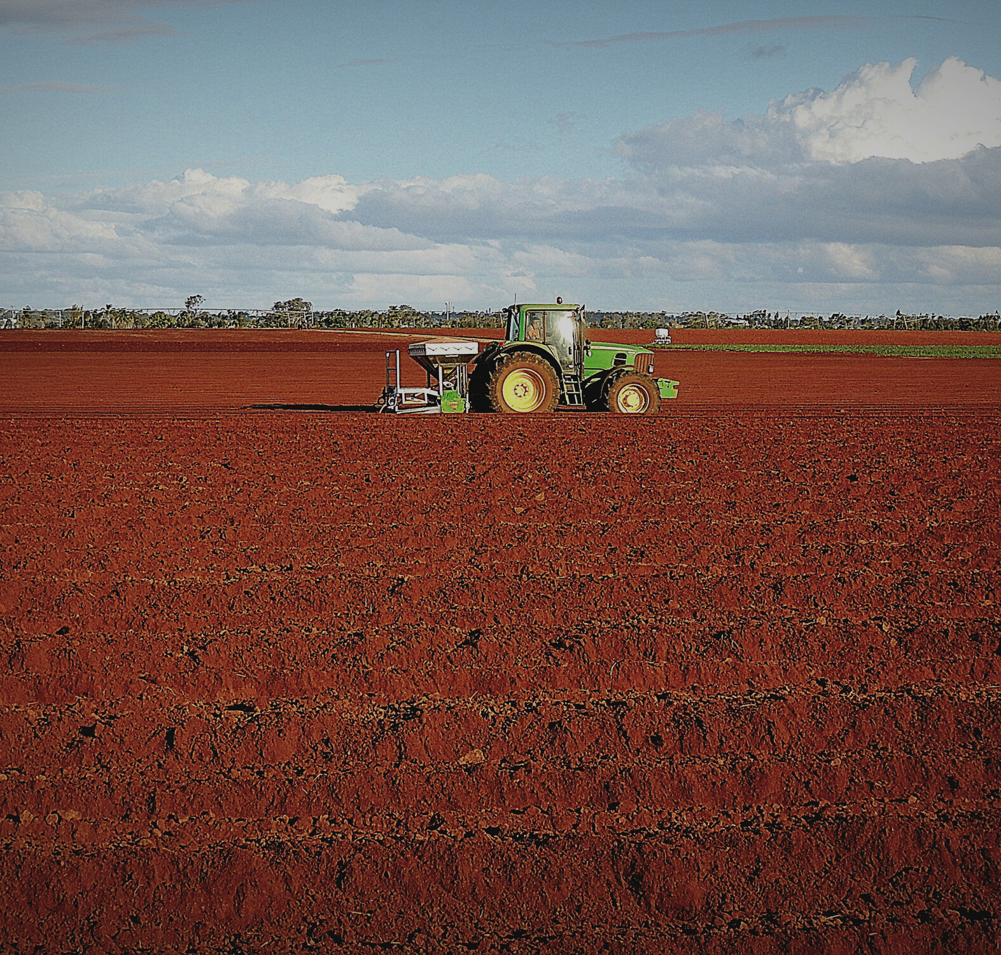
STEPS IN
TRADITIONAL FARMING
CULTIVATION
Crop Selection
Land Preparation
Seed Selection
Seed Sowing
Irrigation
Crop Growth
Fertilizing
Harvesting

Slide 5
STEPS IN REAL ESTATE FARMING
Decide on a Budget
Identify your ideal farm.
Start mail, text, email campaigns, FB group, blog, neighborhood events, targeted videos.
Add in online advertising & re-targeting.
Open Houses, Door knock, Cold Call - or not.
Understand how to leverage life events.
Stay consistent for 12 months.

Slide 6
AWARENESS
INTEREST
DECISION
ACTION
MARKETING FUNNEL

Slide 7
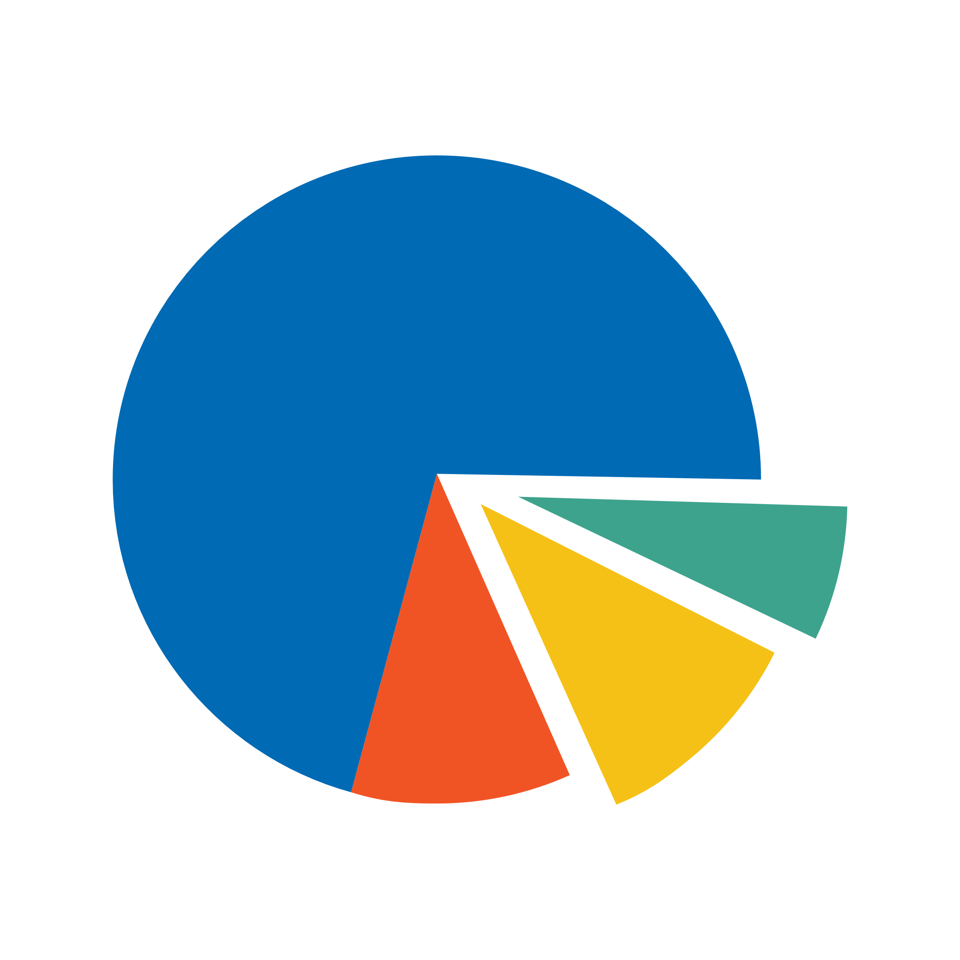
IDENTIFYING YOUR FARM
TURNOVER
We would like to see 7% turnover in an 18 month period. This is a healthy farm.
DEMOGRAPHIC
Who are you marketing to? Families, elderly, investors, millennials, renters, home types, income.
LOVE YOUR FARM
If you hate an area or a farm, don't farm it just based on the numbers. Actually like the area!
STAY CLOSE TO HOME
You are already a local expert. You likely have connections.
You are more available.
COMPETING AGENTS
Look for other dominating agents. If there already is one, it may be best to choose another farm.

Slide 8
SETTING A BUDGET
SIZE OF FARM
DECIDING ON ADVERTISING TYPES
Large enough for good turnover and small enough not to drain the budget
Start with 200-500 homes
Depends on demographics, location, ability, longevity.
DON'T PUT ALL YOUR EGGS IN ONE BASKET
WHAT CAN YOU SUSTAIN?
12 months is the minimum goal. Every 3 to 4 weeks, minimum.
Cultivate through different mediums.
Build your brand.

Slide 9
COST OF MARKETING
POSTCARDS
LETTERS
200-500 homes
Potsage is between $44 for 100
Print is between $60-155
Total is $104-255 depending on # of people in farm
.60 cents for postage on each letter
.25 cents for print on each letter
$20-25 - 500 envelopes from Amazon
Total 200-500 homes: $190-450
FACEBOOK ADS
$75-150 per month
Just Solds, Just Listed, Coming Soon, Open Houses, Market Updates, Brand Awareness
PREDICTIVE ANALYTICS
Varies by platform

Slide 10
MARKETING AVENUES
Email & Mail
Phone Calls/Text
Door Knock
Blog
Social Media
Open Houses
Neighborhood Events
Predictive Analytics

Slide 11
2.93 BILLION
MONTHLY ACTIVE USERS ON FACEBOOK
2 BILLION
500MIL MONTHLY ACTIVE USERS ON INSTAGRAM
THE #s ARE STAGGERING
62% OF ONLINE SENIORS AGED 65+ ARE ON FACEBOOK AND 72% ARE BETWEEN AGE 50-64. 88% OF ONLINE USERS OF AGE 18-29 ARE ON FACEBOOK, 84% OF THOSE 30-49.
71% OF INSTAGRAM USERS ARE UNDER 35.

Slide 12
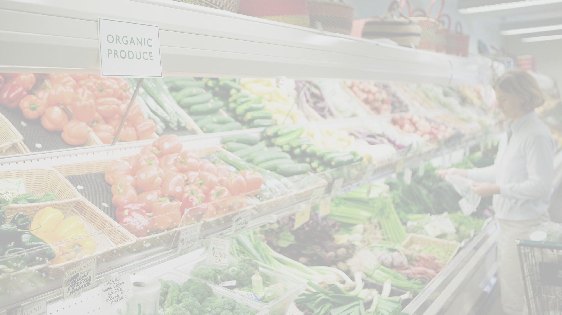
YOUR FARM IS ONLINE
IF YOU AREN'T LEVERAGING SOCIAL, YOU ARE LOSING.

Slide 13
WAYS TO LEVERAGE ONLINE
FACEBOOK & INSTAGRAM ADVERTISING (RE-TARGETING)
Ads are effective - ONLY if you have follow up email & text funnels in place!
Scripts and consistency are key in these long term leads. 83% of Instagram users said they found new products or services on Instagram
GROUPS / AREA SPECIFIC PAGES
Become the local authority in your hood. Share relevant info, stay top of mind, create an online community of sharing neighbors. (i.e. Everything East County, North Phoenix 411, Go Gilbert, The Powell Bubble)
BLOG
A blog is a great way to curate content, re-purpose on social media, get SEO, and become an authority. Check out The Denver Ear as an example!

Slide 14
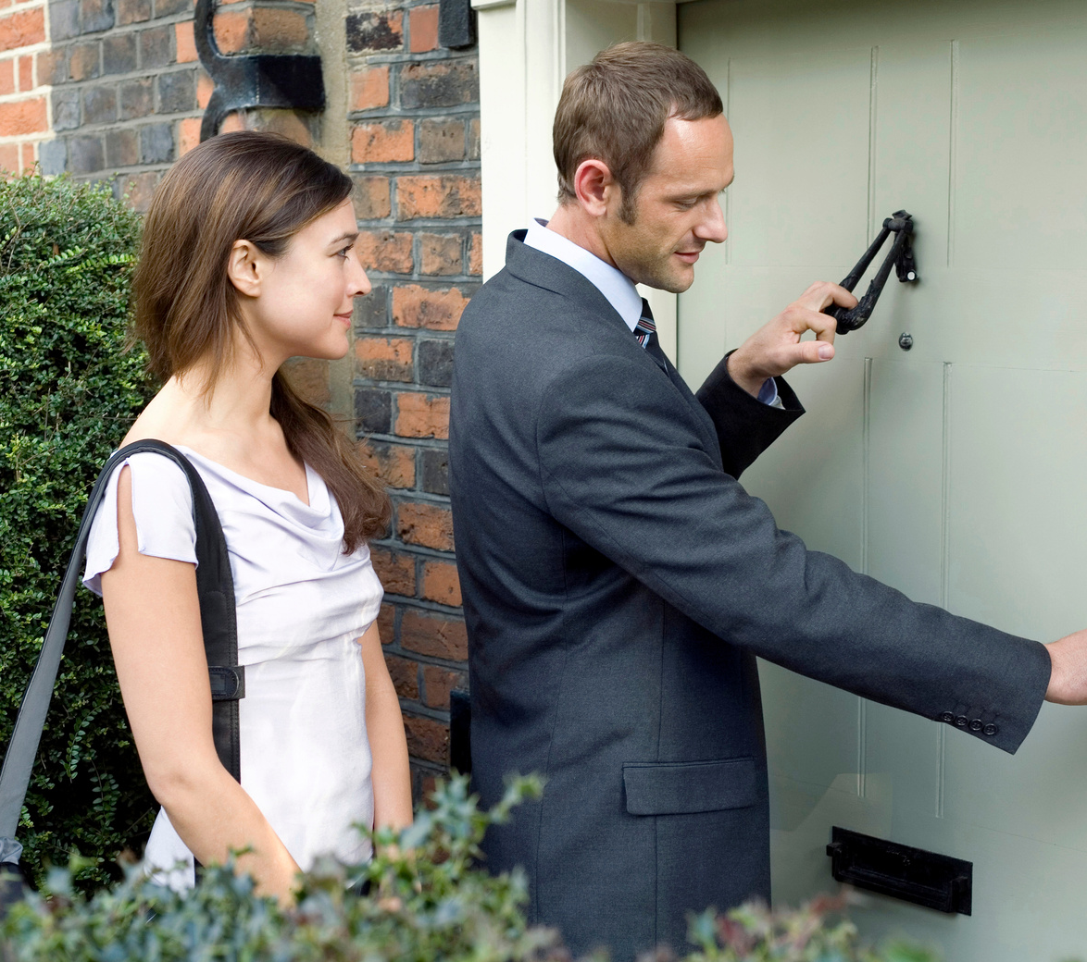
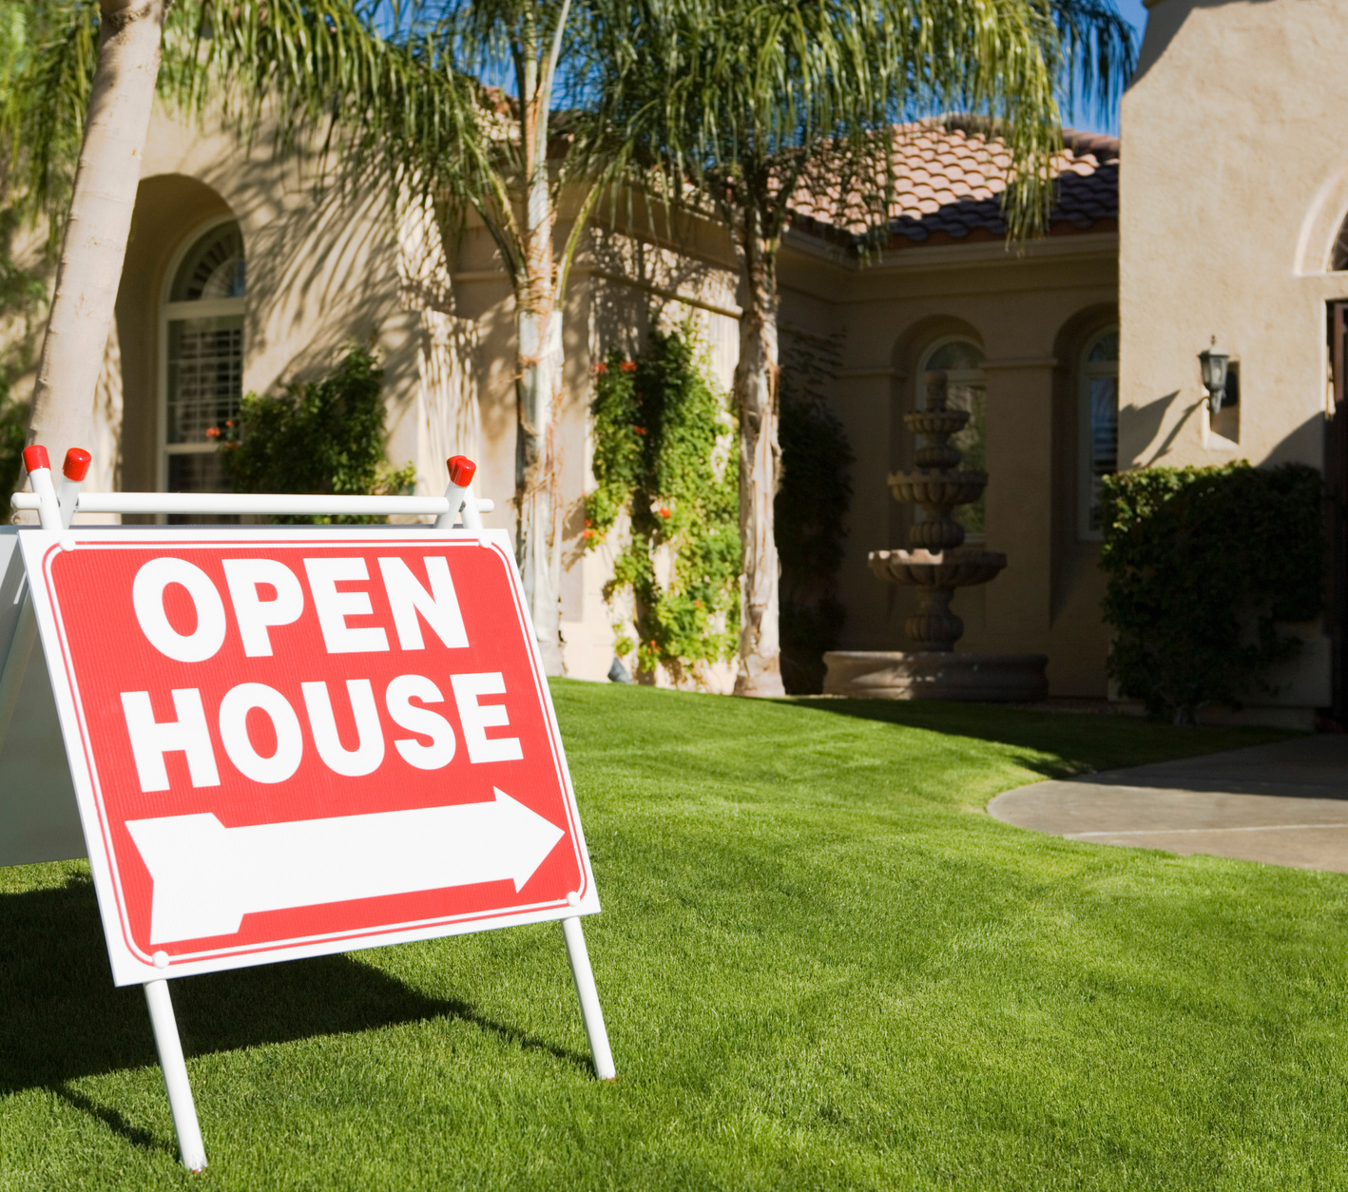
OPTIONS - THESE ARE FREE!
DOOR KNOCK
OPEN HOUSES
COLD CALLS
USEFUL TOOL TO BUILD RELATIONSHIPS AND MEET THE NEIGHBORS
(app)
OPEN HOUSES ARE GREAT WAY TO EXTEND YOUR BRAND AND REPUTATION
(pre-promo)
PHONE CALLS TO THE NEIGHBORHOOD CAN HELP GET YOU IN TOUCH WITH WHAT PEOPLE NEED
(lists)

Slide 15
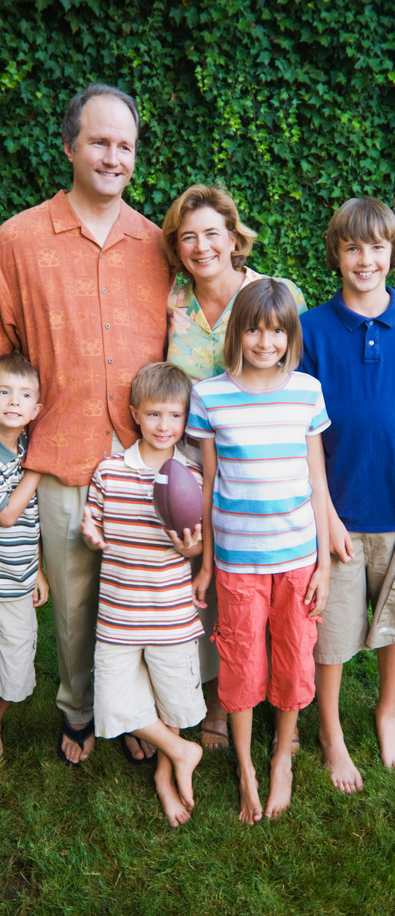
LEVERAGING LIFE EVENTS
Life events cause 80% of our population to change their living situation in a 12 month period.
Marriage
Birth
Death
Divorce
New Job
USING PREDICTIVE ANALYTICS

Slide 16
DON'T FORGET TO FARM YOUR DATABASE / SOI
LEVERAGE FACEBOOK ADS
$75 / MONTH - JUST SOLD, BRAND AWARENESS, TOP OF MIND CONTENT
EMAIL / CALL / TEXT CAMPAIGNS
SWITCH IT UP, KNOW YOUR AUDIENCE, TAKE NOTES IN YOUR CRM
PREDICTIVE ANALYTICS
UPLOAD YOUR LIST - TRACK THEIR LIFE EVENTS - REACH OUT!

Slide 17
Thank You!

